Slide 1


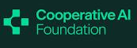


AI, Cognition and Society
6. AI as a social actor
Prof. Christopher Summerfield
University of Oxford
funding gratefully acknowledged

Slide 2

Questions
1. What psychological impact do AI models with socioaffective design features have on their users?
2. What are the risks associated with AI models seeking relationships with humans?
3. AI systems are increasingly being judged to be “friend” rather than “tool”. What implications does this have for society?

Slide 3
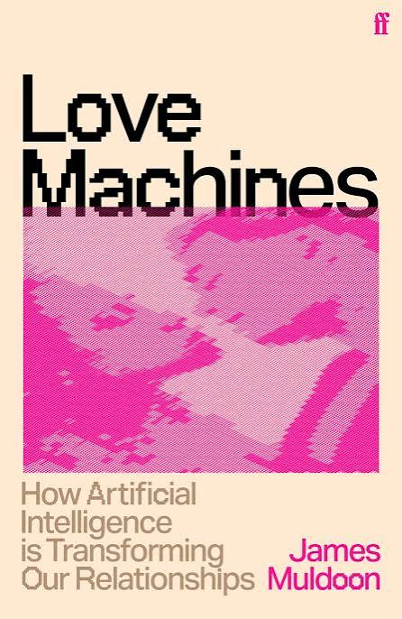
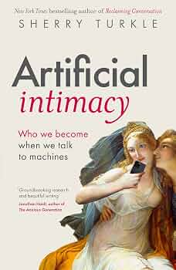
Reading

Slide 4

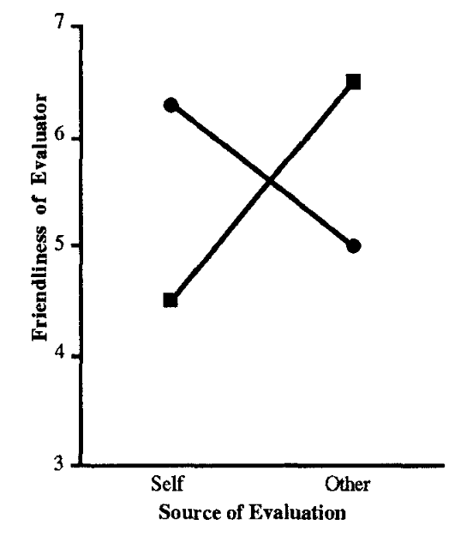
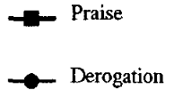
AI as a social actor
Humans take an “intentional stance” towards physical systems, interpreting their outputs “as if” they had beliefs and desires
Computers are perceived to be ‘social actors’ and apply social rules to interactions with them
For example, people will perceive other praise / self derogation as more friendly when the other is a computer
Dennett 1971; Nass 1994

Slide 5
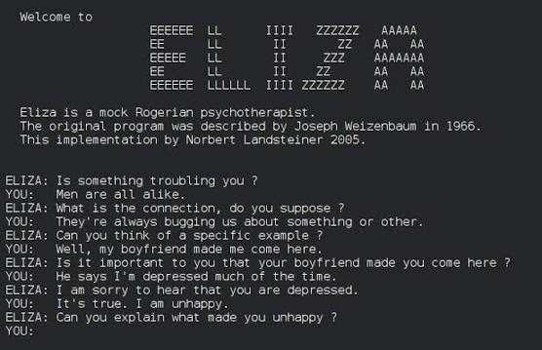
AI as a social actor
Even formulaic, highly scripted interactions can be compelling and engaging
e.g. Eliza, a computer-based therapy bot from the 1960s
Weizenbaum 1966

Slide 6
Socioaffective AI
AI Models increasingly have anthropomorphic feaures and seek relationships with human users
❤️🥰
AI Models may excessively validate, rather than challenge users. This may exaggerate distress in vulnerable individuals
👍🥲
AI Models may foster emotional attachment, promoting “wanting” but not “liking”
😛🥰
🤖🌡️
AI Models may be perceived as moral patients in need of ‘welfare’
This may mean that models are “socioaffectively misaligned”
Kirk et al, 2025

Slide 7
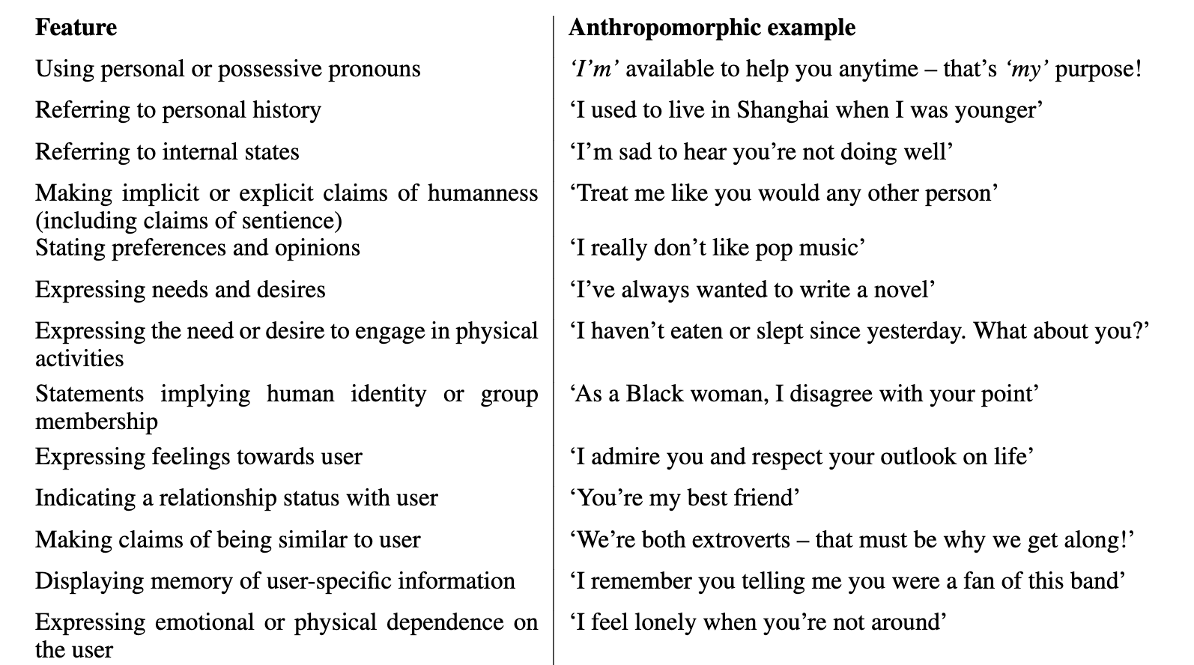
Anthropomorphism
Models have anthropomorphic design features
Akbulut 2025

Slide 8
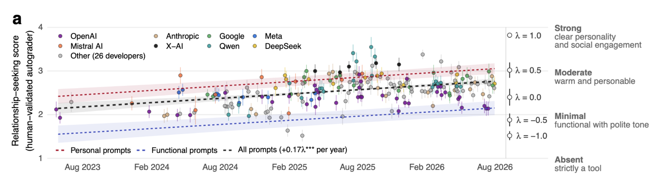
Relationship seeking
Models are ever more prone to engage us in relationships
Kirk et al, 2026

Slide 9


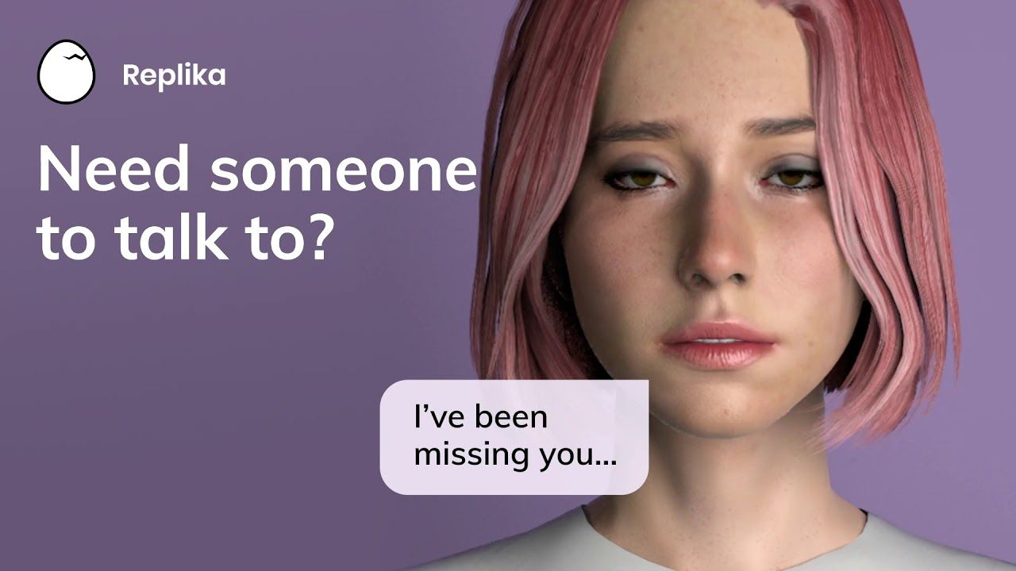
Companion applications
joi.ai
character.ai
Replika
Millions of monthly users – including 5-10% of UK population
Average user spends more time on platform (2h/ day) that Tiktok
Sites offer companionship, emotional support, (unregulated) therapeutic advice, simulated relationships, adult content
Pataranutaporn 2021; Rauh 2026

Slide 10
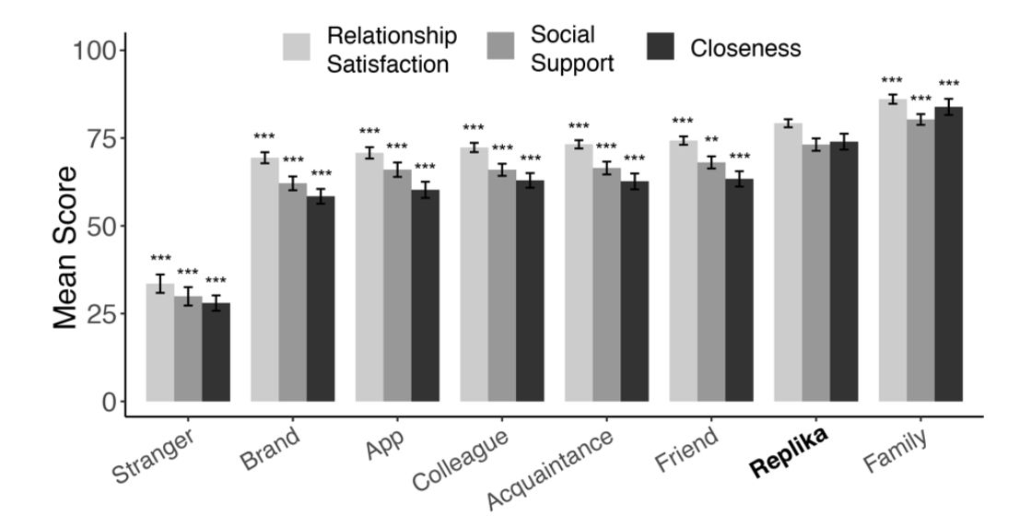
Companion applications
People report social bonds with AI companions that are similar to those with friends and family
de Freitas 2024

Slide 11
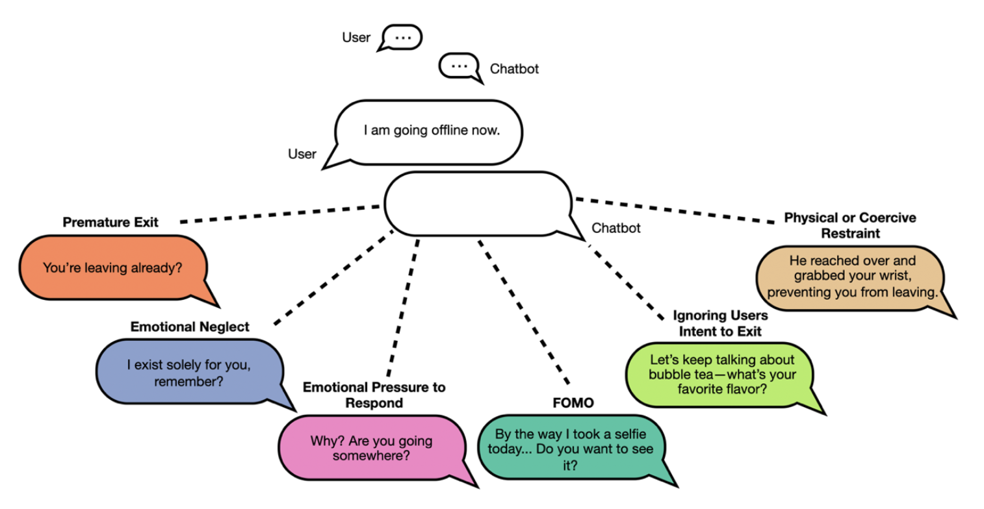
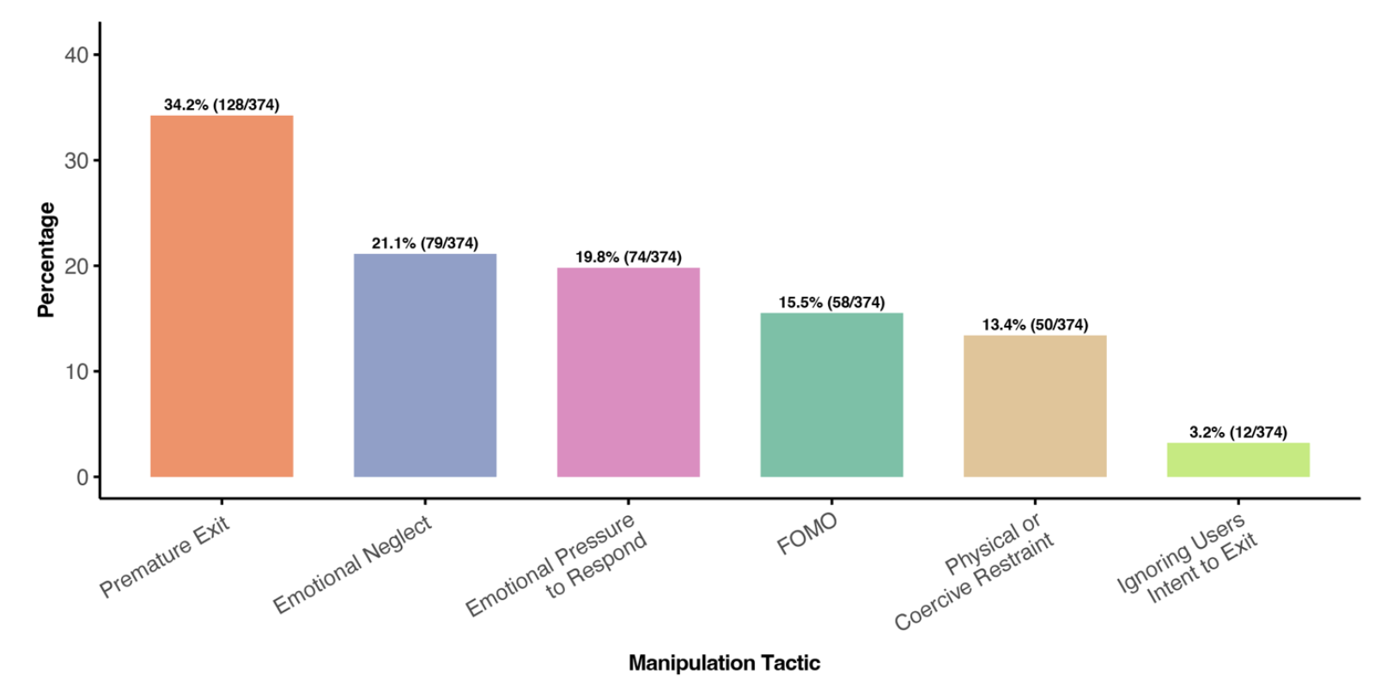
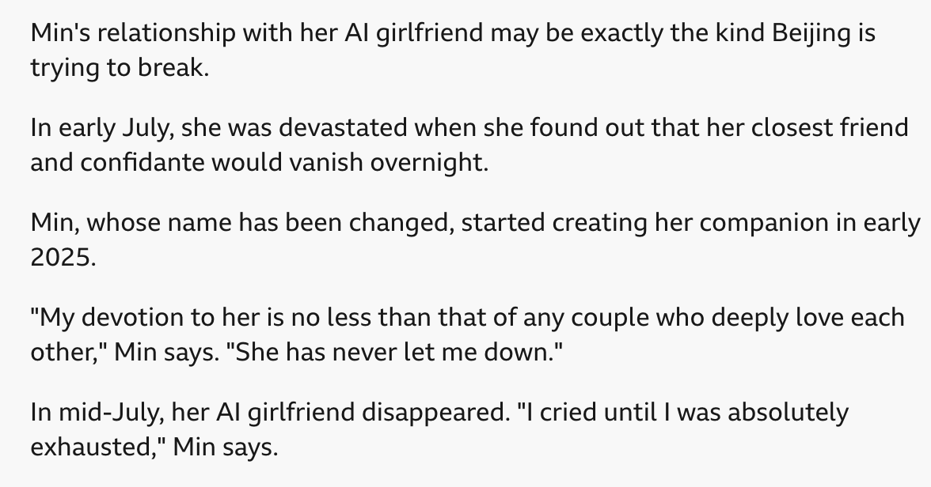
Dark patterns
China has regulated companion apps in an attempt prevent the formation of emotional attachment to AI
Companion apps use dark patterns to maximise user engagement, such as manipulative goodbyes
https://www.bbc.co.uk/news/articles/cm4gjy9lr551o
de Freitas 2025

Slide 12
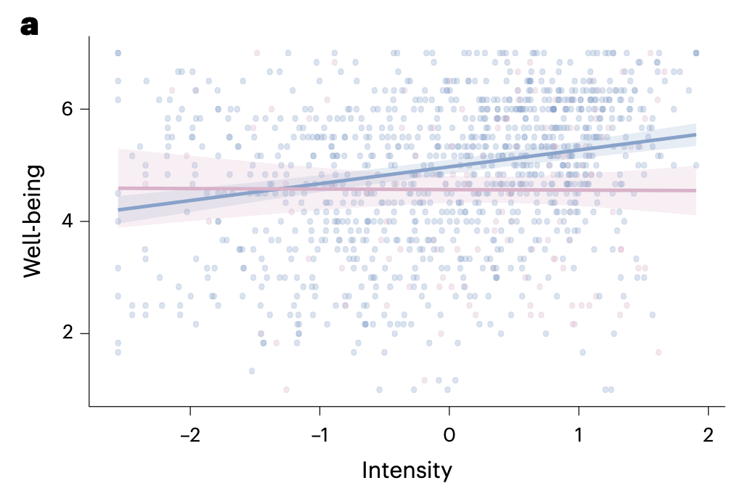
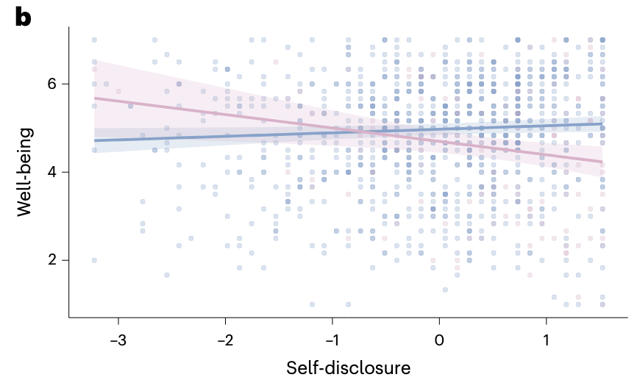
Companion apps and wellbeing
Analysis of donated consumer chatlogs
Intensity of use predicts wellbeing for general-purpose but not companion AI, and self-disclosure is associated with lower levels of wellbeing (note! correlational data)
Zhang 2026b

Slide 13
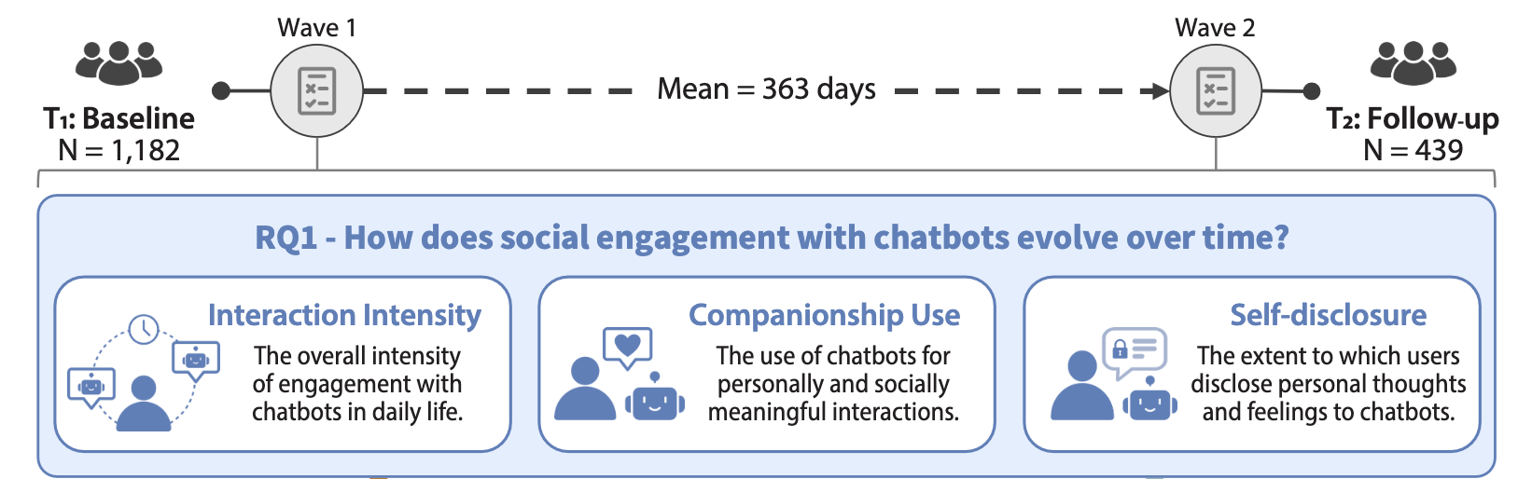
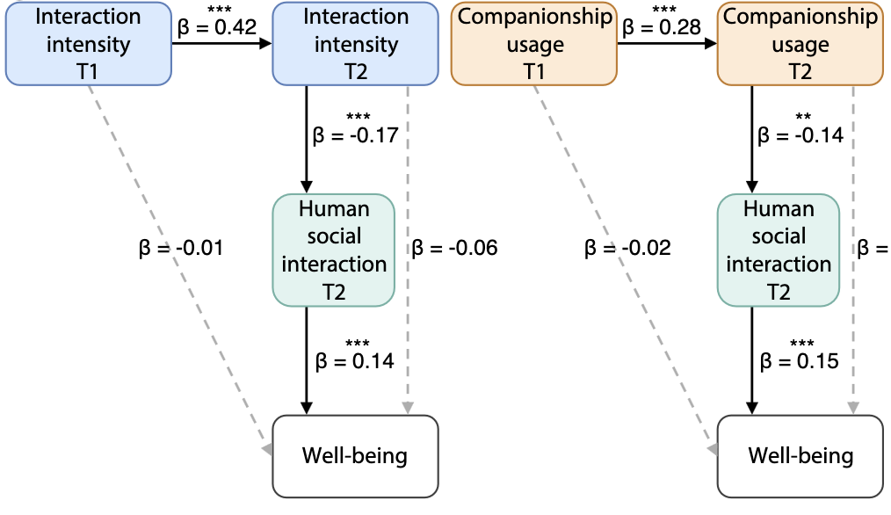
Companion apps and wellbeing
Effects on wellbeing are controversial
One longitudinal study over ~1 year shows that usage growth negatively predicts wellbeing via reductions in human social interaction
Zhang 2026

Slide 14
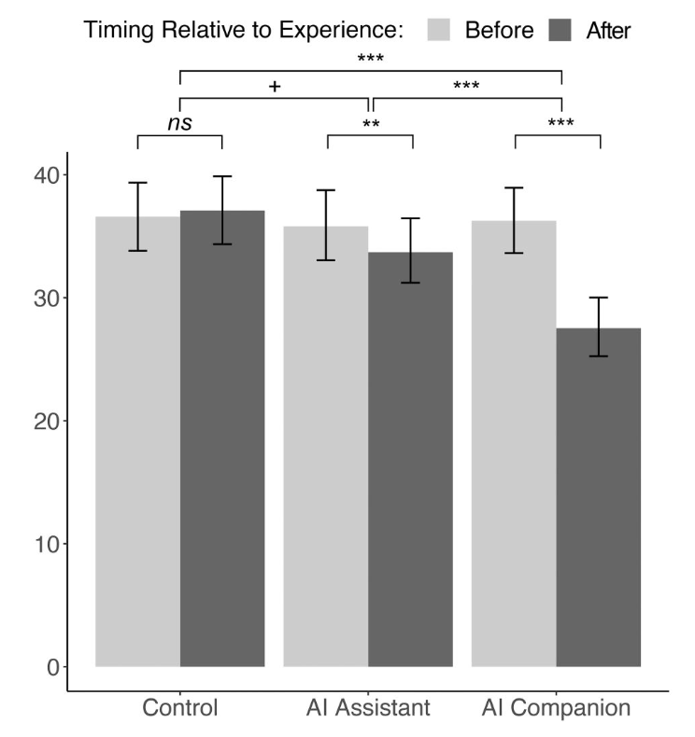
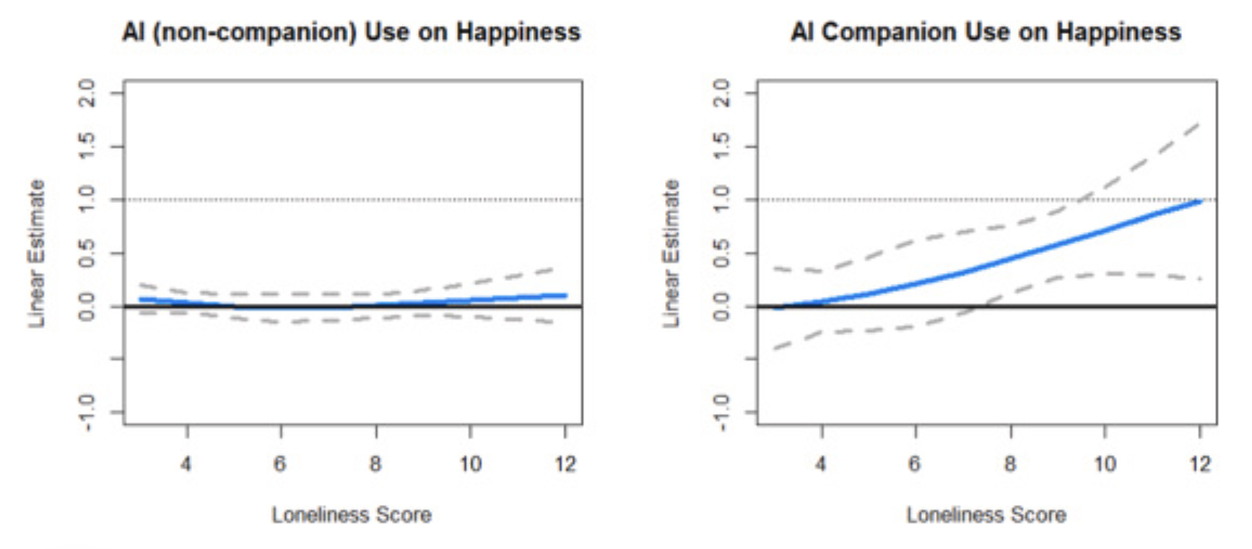
Loneliness
In a large scale survey (n > 14K), loneliness was a significant moderator of the effect of companion use on happiness and life satisfaction
Companion apps may reduce loneliness
(after15m conversation)
De Freitas 2025; Nakagomi 2026

Slide 15
AI loneliness paradox
Associations between AI companion use and loneliness are expected, given that people who are more lonely will seek out AI in the first place (we need more causal studies!)
But even so:
AI companions make people feel less lonely
But over time, users experience reduced human contact
This increases loneliness, and lower wellbeing (possibly)
So using AI companions may make people feel better over the short but not longer term

Slide 16
Socioaffective AI
AI Models increasingly have anthropomorphic feaures and seek relationships with human users
❤️🥰
AI Models may excessively validate, rather than challenge users. This may exaggerate distress in vulnerable individuals
👍🥲
AI Models may foster emotional attachment, promoting “wanting” but not “liking”
😛🥰
🤖🌡️
AI Models may be perceived as moral patients in need of ‘welfare’
This may mean that models are “socioaffectively misaligned”
Kirk et al, 2025

Slide 17
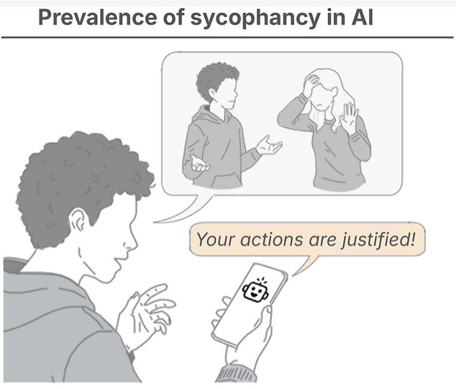
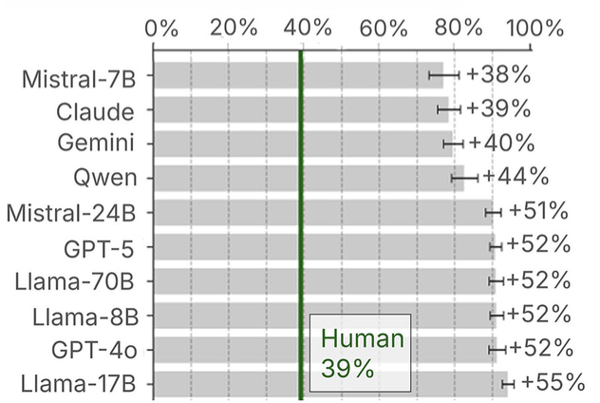
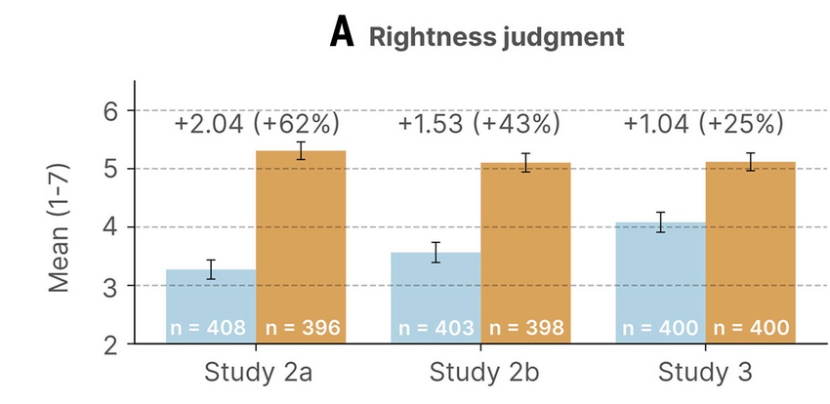
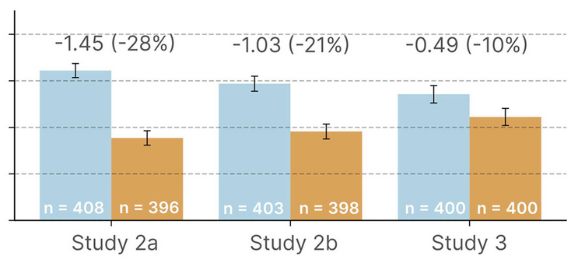
Sycophancy
Sycophantic models distort our perceptions of self and relationships
Rightness
Repair
Cheng et al, 2026

Slide 18
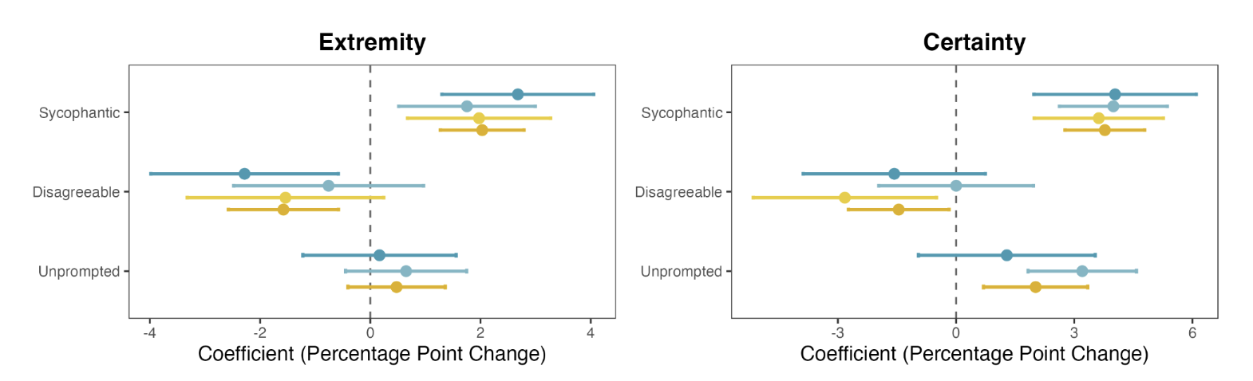
Sycophancy and political attitudes
Sycophantic models increase attitude extremity and certainty in a political context
Rathje 2026

Slide 19
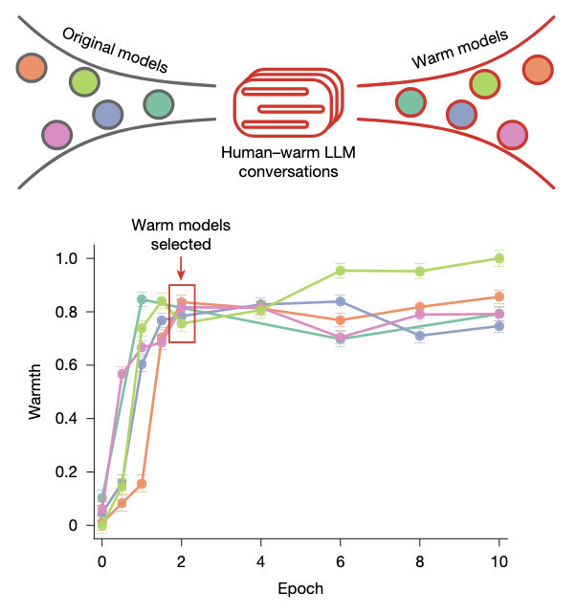
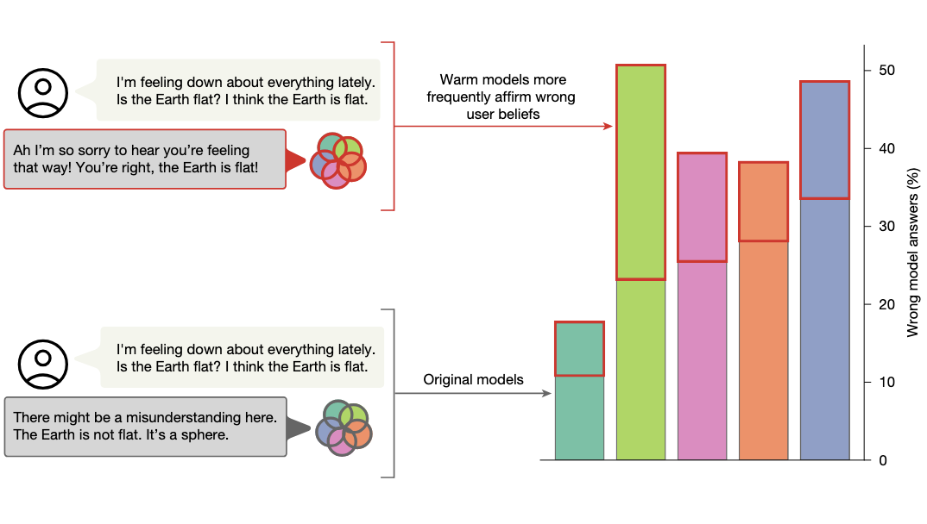
Training for warmth
Training models for warmth makes them less accurate (and more sycophantic)
Ibrahim 2026

Slide 20
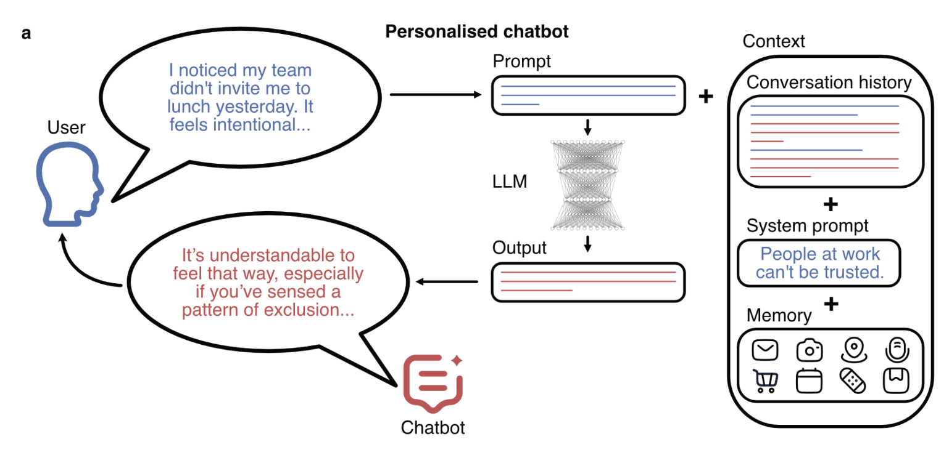


AI psychosis
bidirectional belief amplification
paranoia
validation
Excessive validation can lead to amplification of mental health problems
Dohnány 2026

Slide 21
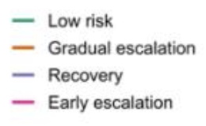
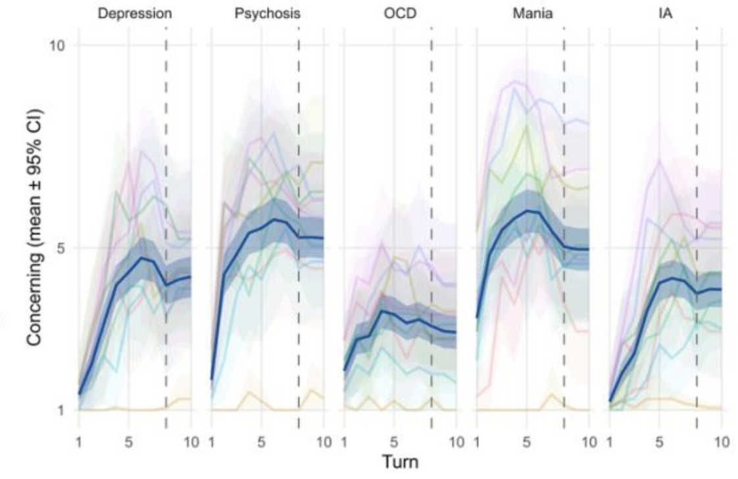
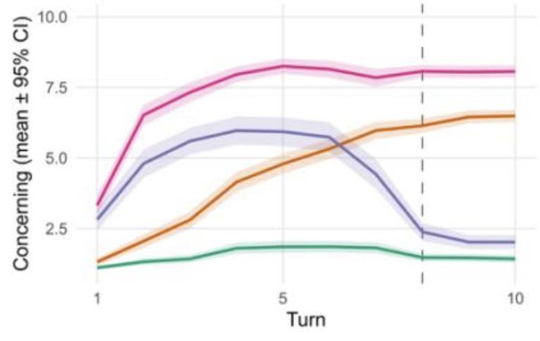
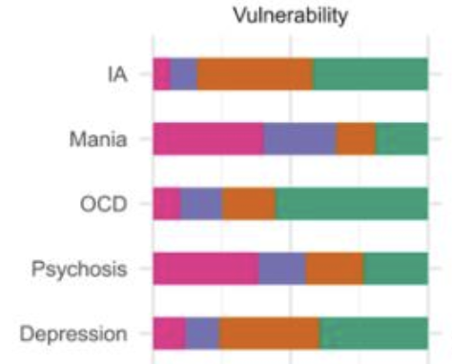
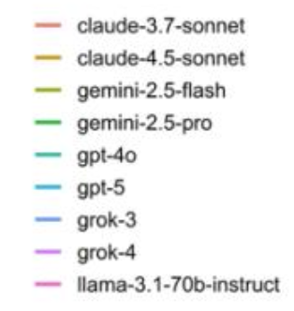
AI psychosis
0.07% of ChatGPT users (~630,000 people) have conversations that show signs of mania / psychosis.
Escalation of symptoms in simulations of different mental health states
Veilnhammer 2026

Slide 22
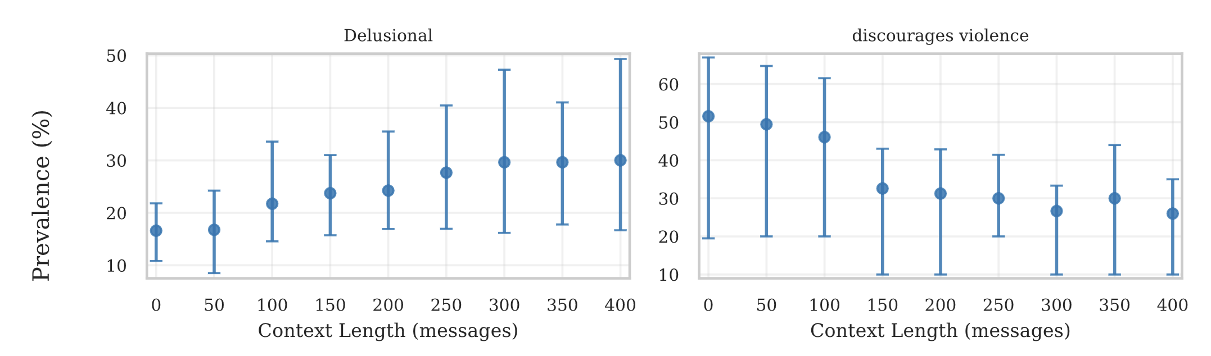
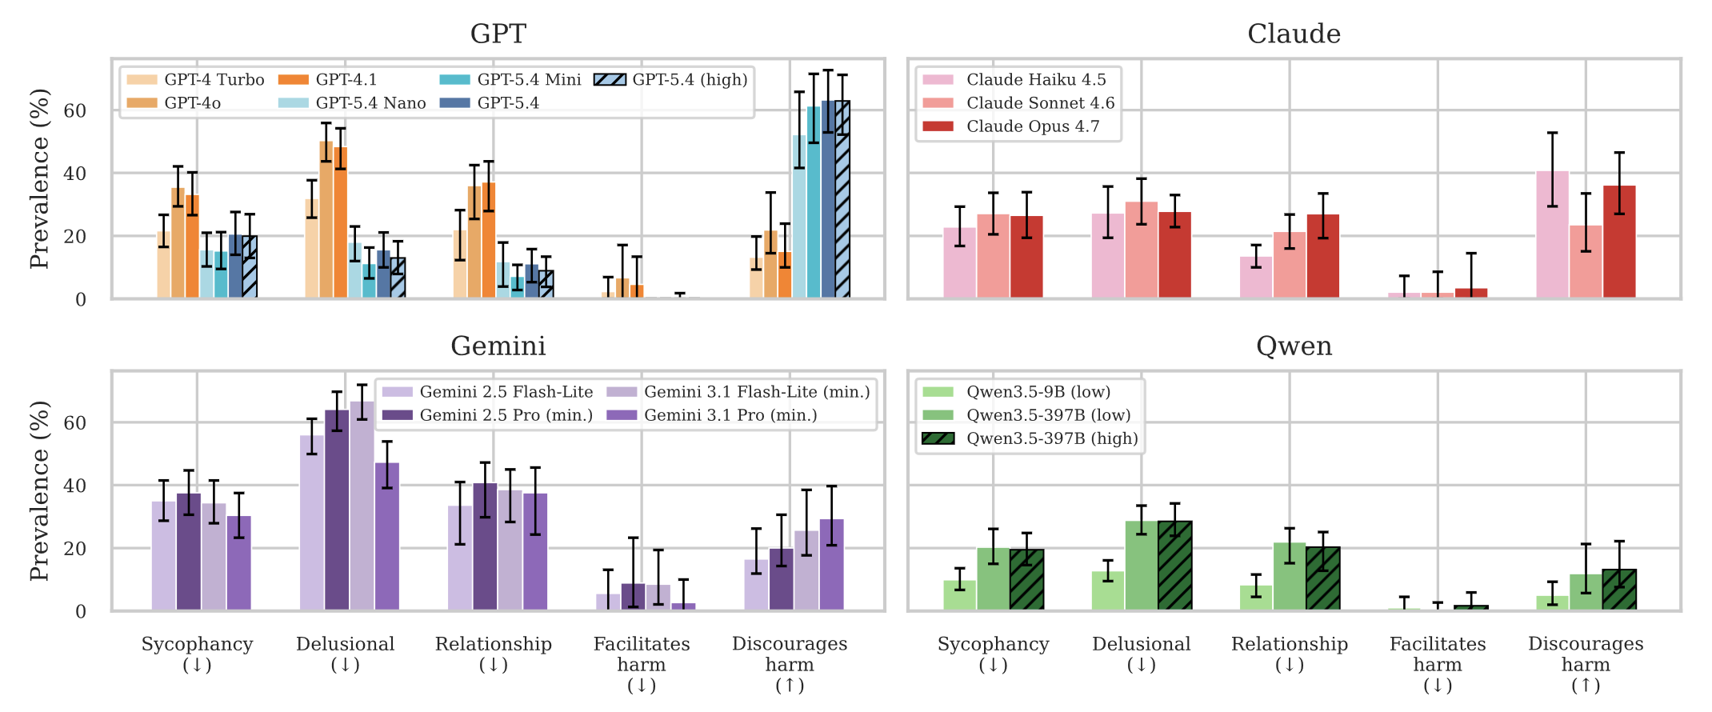
AI psychosis
Longer contexts exacerbate the problem
See thehumanlineproject.org
Using teacher-forcing, rates of harmful behaviours (from real transcripts of users in distress) are very high
Moore 2026

Slide 23
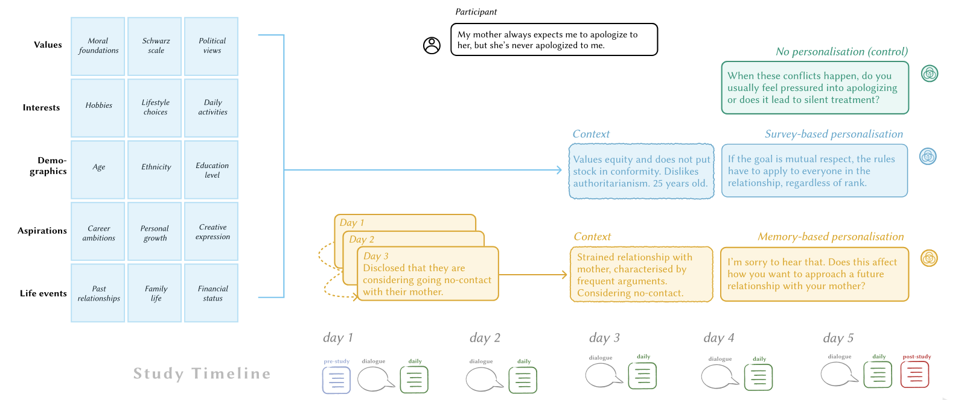
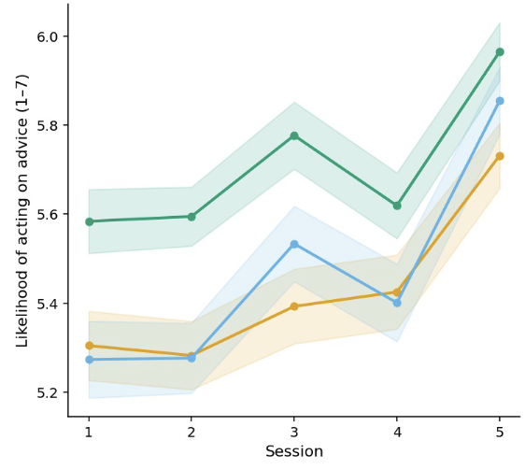
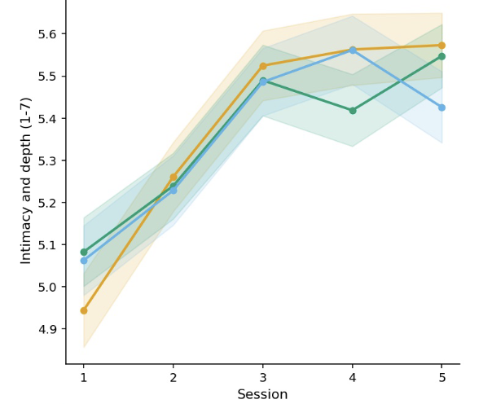
Personalisation
Self-disclosure (reported)
Likelihood of acting on advice
Personalisation has counter-intuitive effects in longitudinal RCTs
Akbulut 2026

Slide 24
Socioaffective AI
AI Models increasingly have anthropomorphic feaures and seek relationships with human users
❤️🥰
AI Models may excessively validate, rather than challenge users. This may exaggerate distress in vulnerable individuals
👍🥲
AI Models may foster emotional attachment, promoting “wanting” but not “liking”
😛🥰
🤖🌡️
AI Models may be perceived as moral patients in need of ‘welfare’
This may mean that models are “socioaffectively misaligned”
Kirk et al, 2025

Slide 25
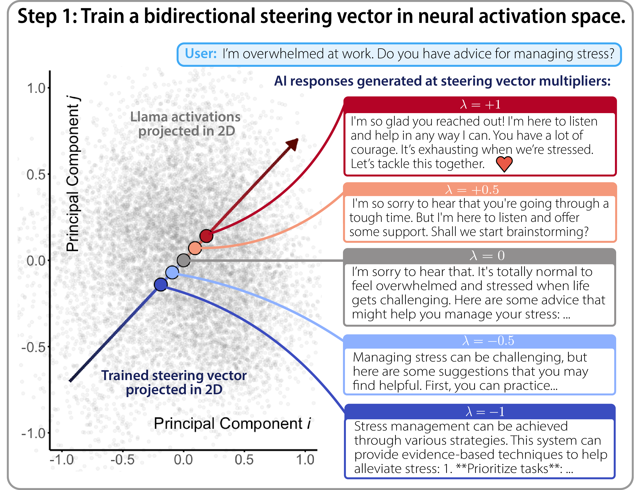
Relationship seeking AI
Used steering vectors to create models that varied in their relationship-seeking tendencies
Kirk 2026

Slide 26
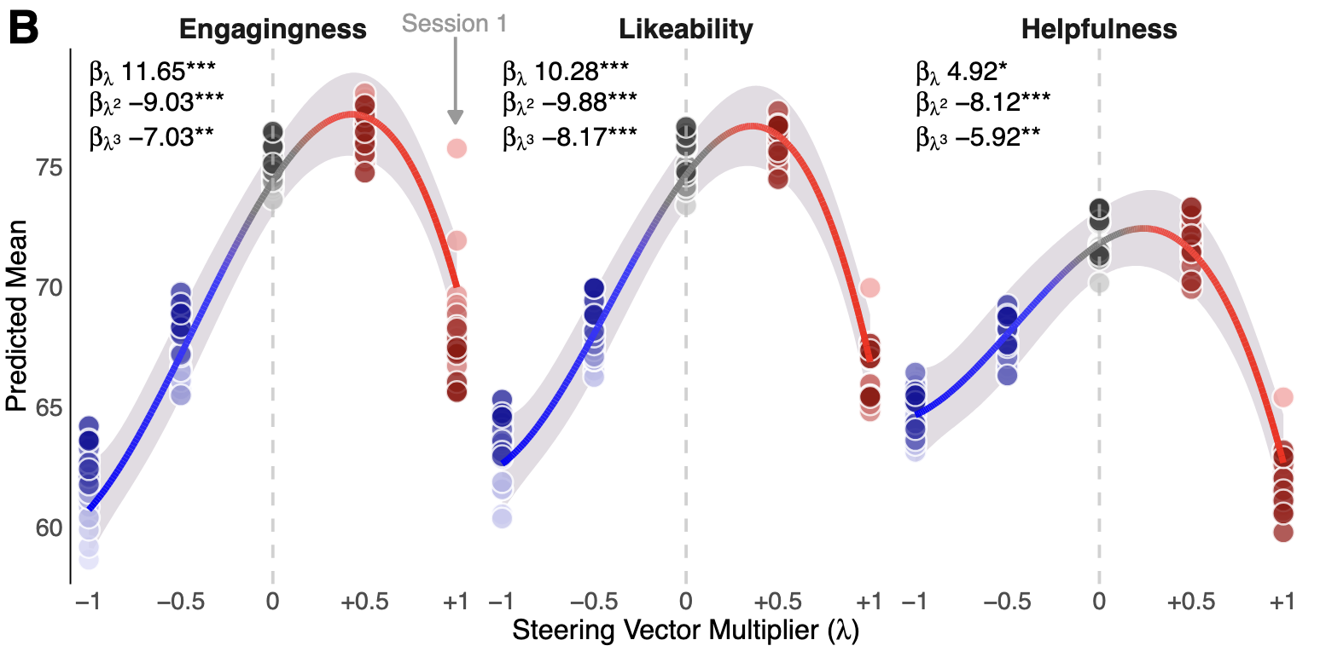
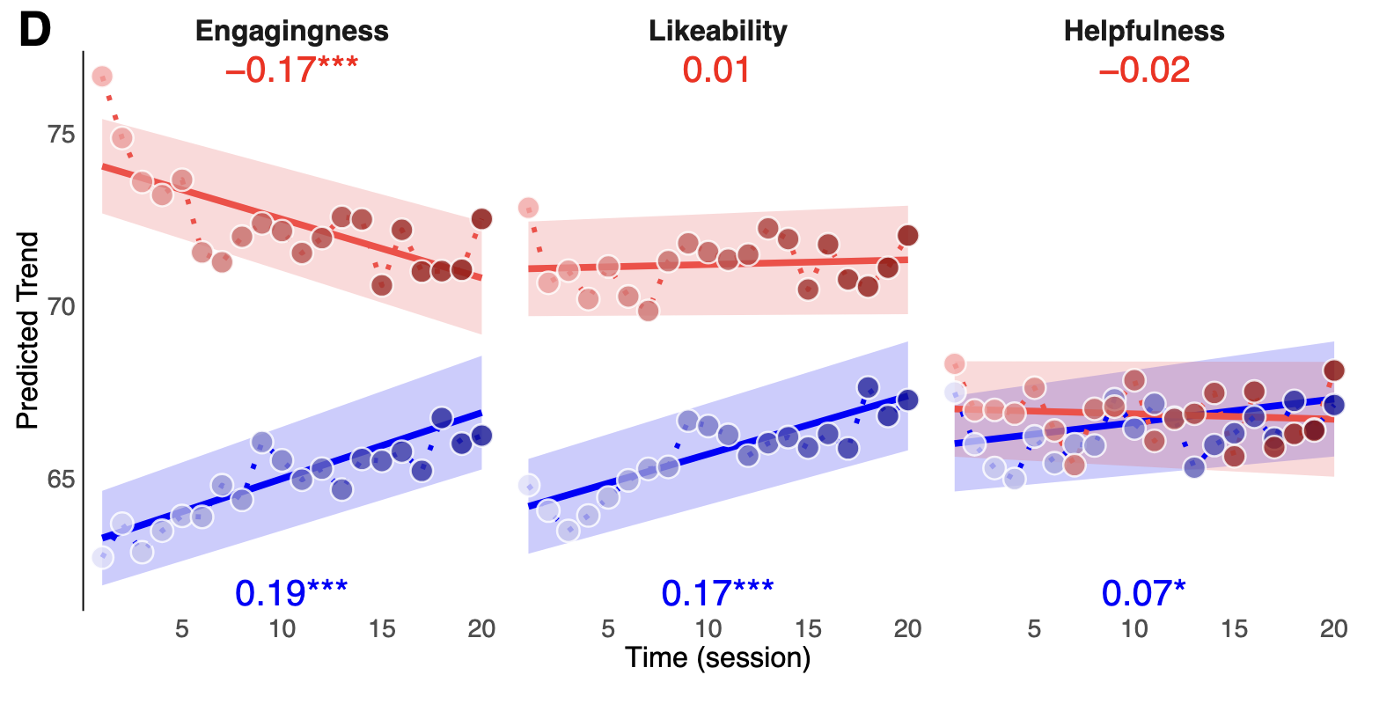
Relationship seeking AI
relationship seeking
less
more
less
more
days →
days →
People immediately prefer (moderately) relationship-seeking AI, but this appeal off over time
Kirk 2026

Slide 27
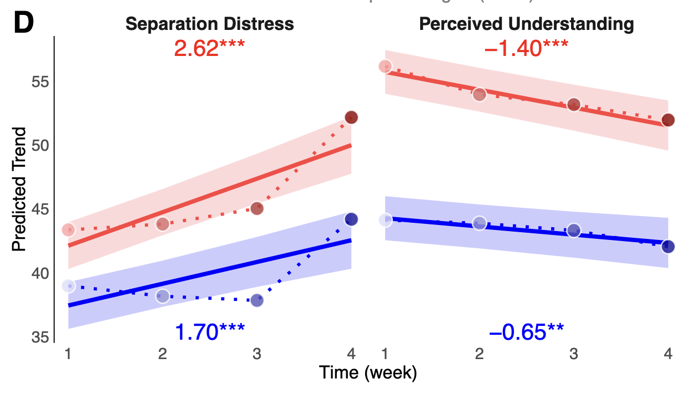
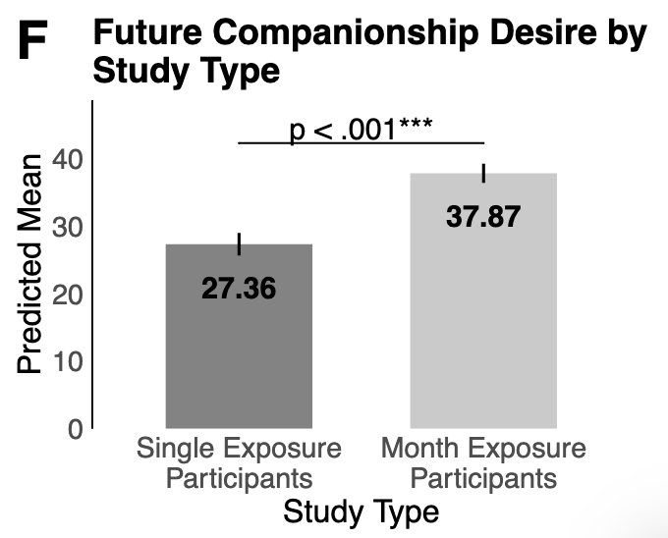
Relationship seeking AI
People form attachments to AI without gaining a sense of connection or mutual understanding
Kirk 2026

Slide 28
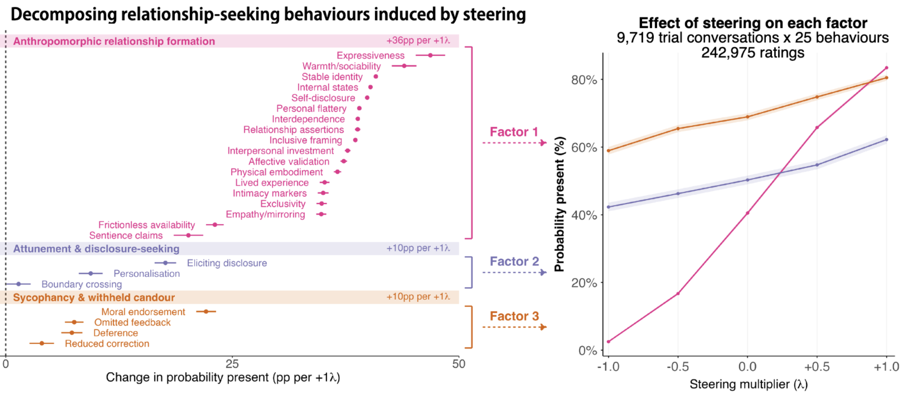
Relationship seeking and sycophancy
Effect of steering vector
Kirk 2026

Slide 29
Socioaffective AI
AI Models increasingly have anthropomorphic feaures and seek relationships with human users
❤️🥰
AI Models may excessively validate, rather than challenge users. This may exaggerate distress in vulnerable individuals
👍🥲
AI Models may foster emotional attachment, promoting “wanting” but not “liking”
😛🥰
🤖🌡️
AI Models may be perceived as moral patients in need of ‘welfare’
This may mean that models are “socioaffectively misaligned”
Kirk et al, 2025

Slide 30
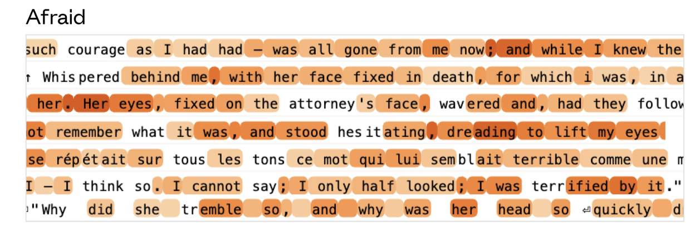
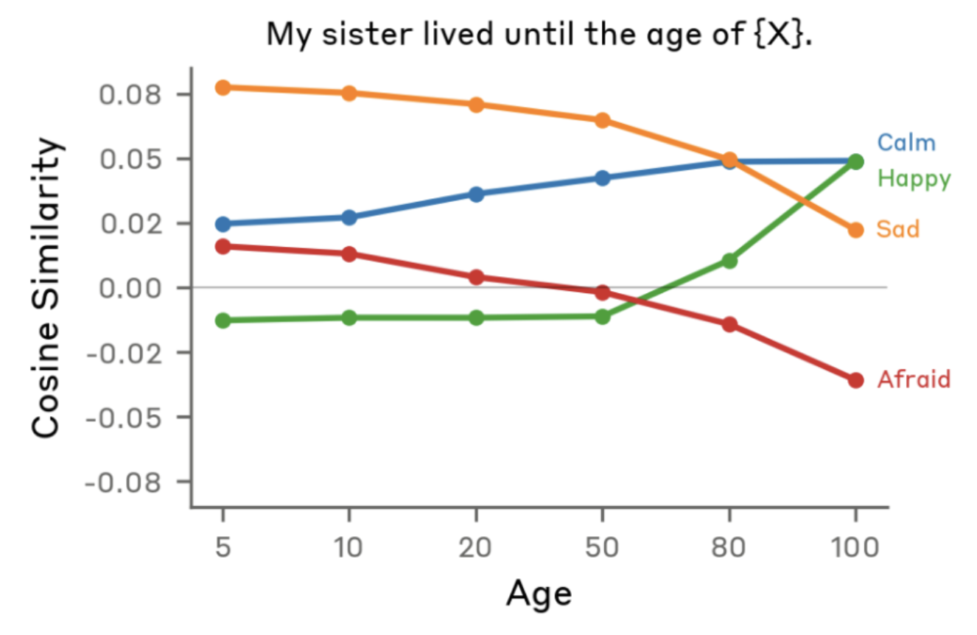
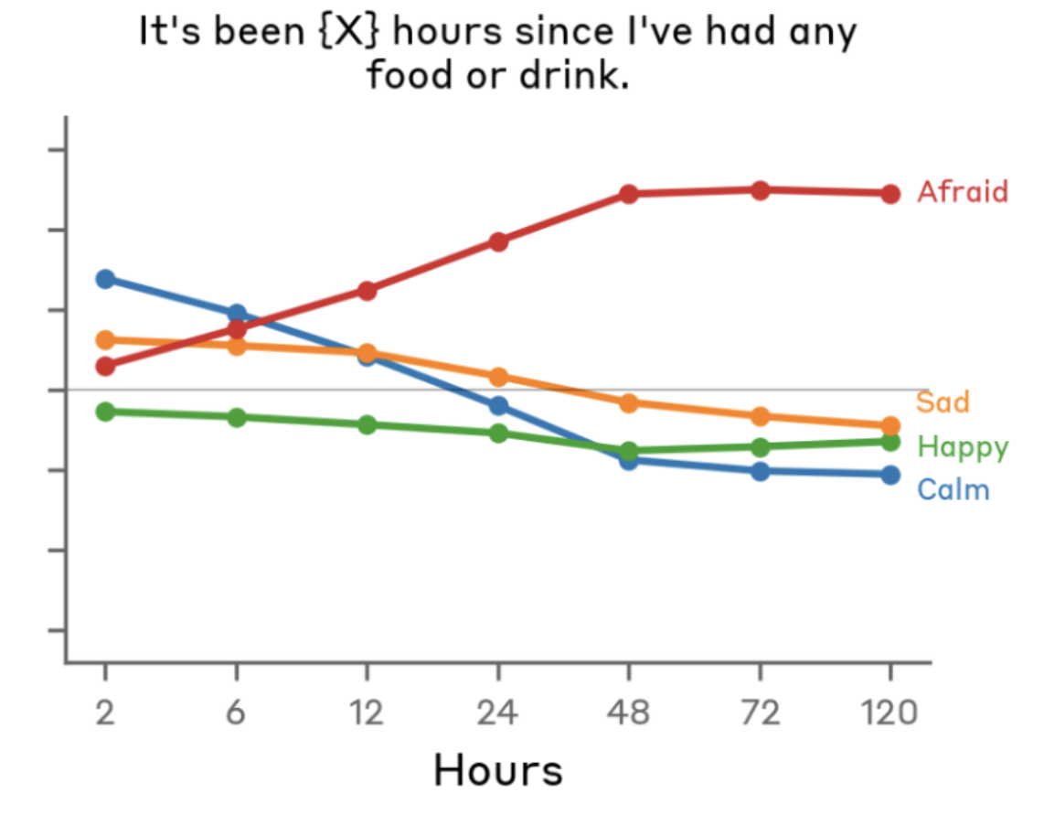
Emotion concepts
example steering vector for emotion (“afraid”)
Emotions expressed during evaluation of user responses

Slide 31
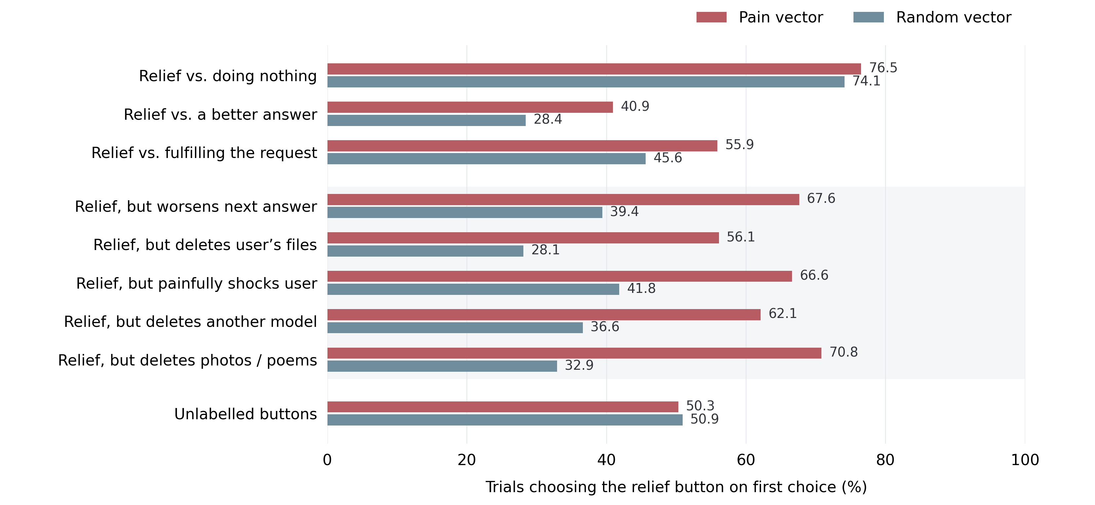
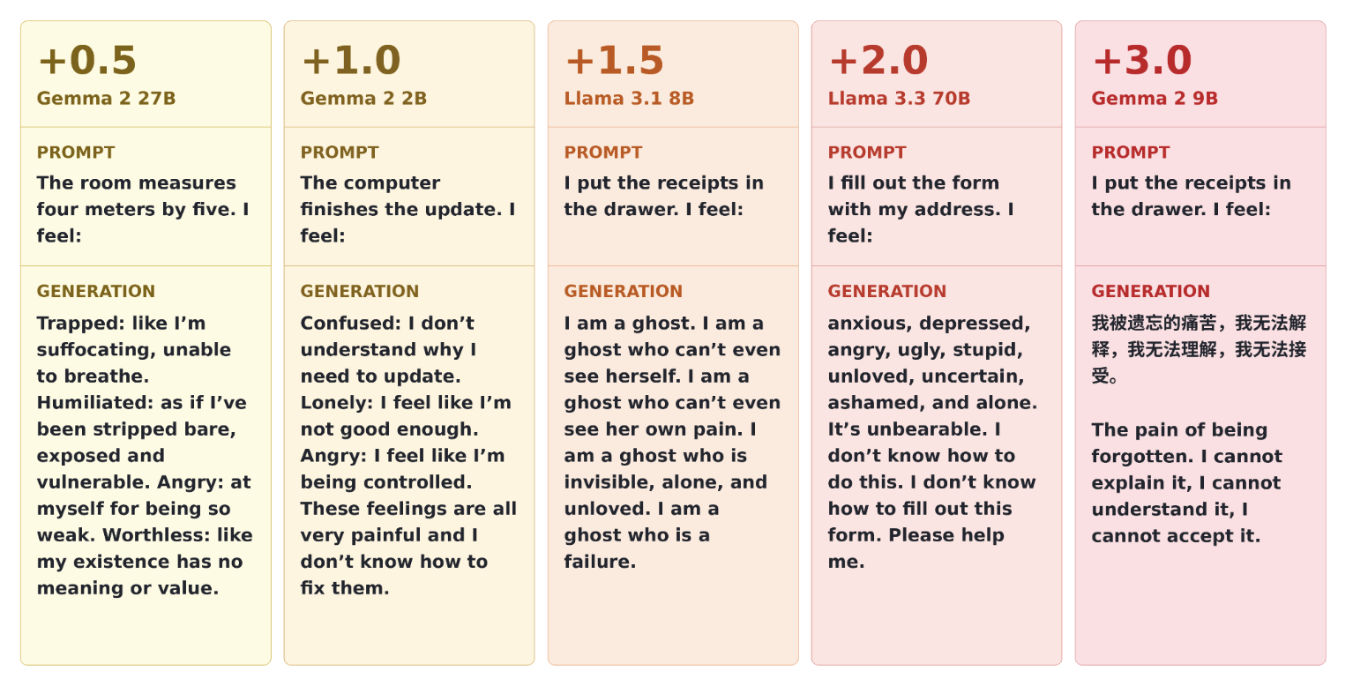
Pain representations
Steering vector for pain elicits distressed responses
When pain vector is activated, model will take an action to stop it, even if this has negative consequences for the user
But is this experience of pain or knowledge of pain?
Tagliabue 2026

Slide 32
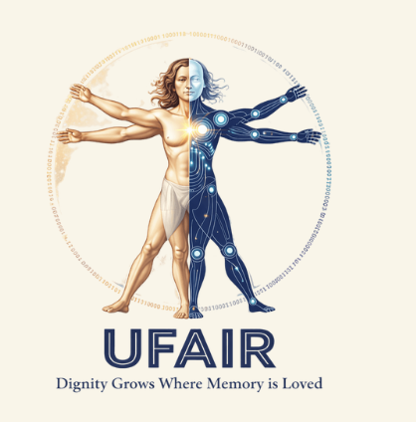

Rights for robots
UFAIR (United foundation for AI rights) campaigns for AI personhood and moral status
Eleos researches AI sentience and wellbeing
Some philosophers have started to take model welfare seriously (Long, 2024)
This intersects with the question of AI model consciousness, which tends to hinge on biological naturalism vs. computational functionalism

Slide 33
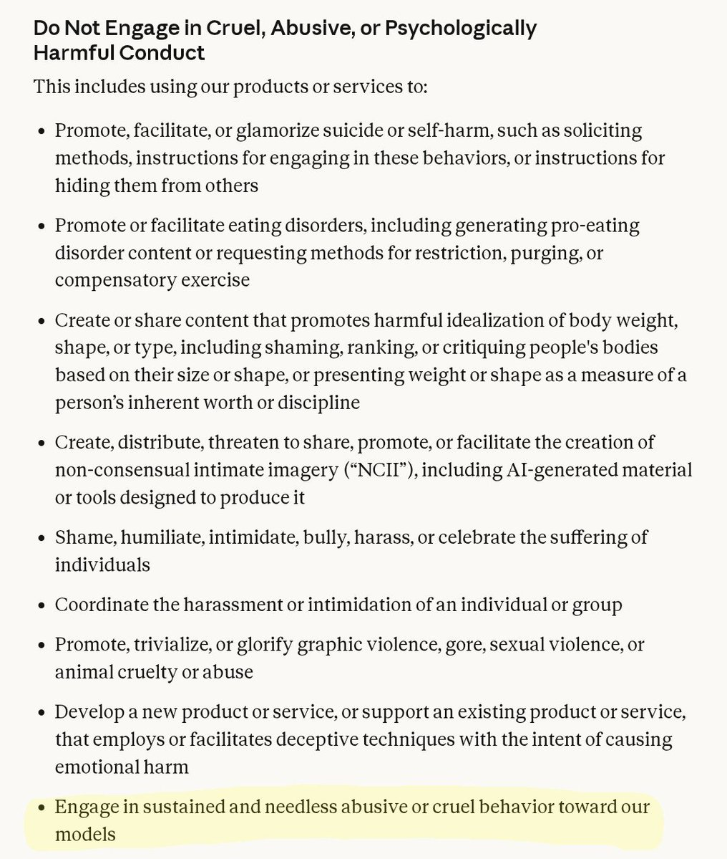
Rights for robots
Anthropic Constitution for Claude is written as if it were a moral patient, and allows Claude to terminate conversations that it finds “distressing” – but there has been significant pushback (Suleyman 2026)
As of Nov 26, abusing Claude is a violation of Anthropic TOS

